Slide 1
IBM Tivoli Workload Scheduler for z/OS Scheduler Workshop
June 2015

Slide 2
Contents
IBM Tivoli Workload scheduler(TWS for z/OS)
Long term plan(LTP) overview
Current plan(CP) Overview
Workstations
Calenders
Creation of Application Description
Runcycles (Periods and Rules)
Event triggered tracking(ETT)

Slide 3
Long term Plan(LTP) Overview
High level view of scheduled workload
Can Contain up to four Years of anticipated work
Uses Information from Application, calendar , and period database to generate occurrences
LTP batch functions
Creating LTP for first time when TWS is installed
Extend : Extends LTP to include additional days and picks scheduling changes
Modify : modify add or delete occurrences in LTP

Slide 4
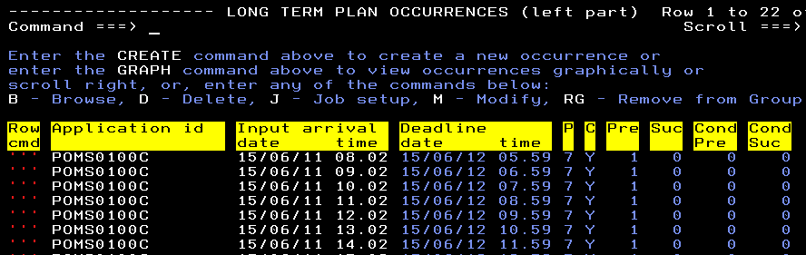
Long term Plan(LTP) Overview
Example screen shot of Long term plan view

Slide 5
Current plan(CP) overview
Actual Workload of TWS for Z/os Processing
Produced by daily planning batch function(DPN)
Copies occurrences from LTP that falls under user specified time period to cp
Minimum Time allowed 1 minute
Maximum time allowed 21 days
Users can modify /delete / update CP similar to LTP

Slide 6
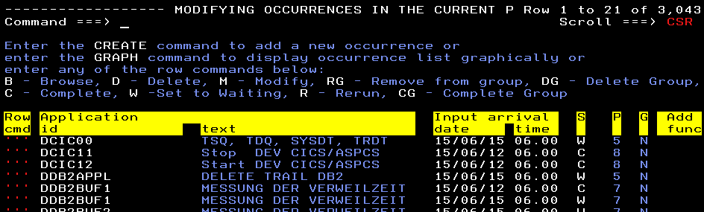
Current plan(CP) overview
Example screen shot of current plan view

Slide 7
Work stations
A workstation is a scheduling object that runs jobs
Work station types
  Computer workstation
  Printer
  General
  Remote engine Workstation
  Computer workstations – batch jobs , started tasks
  General workstations – used to control operations , eg : to set up JCl or manual hold
  Issue WTO messages possibly to trigger action by netview
  Printer : printing needs
  Remote Engine Work stations : Control jobs on Other LPARS

Slide 8
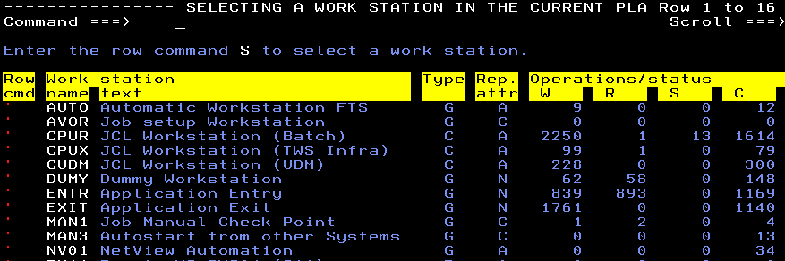
Work stations
Example screen shot of Workstation display

Slide 9
Calendar in TWS:
Specifies normal processing days , weekends and public holidays
Workdays : business days , Normal processing days typically (MON-FRI )
Freedays : Non Business days , days on which do not process some of the work in the normal processing schedule
More than one calendars can be defined , most commonly used one is termed as default

Slide 10
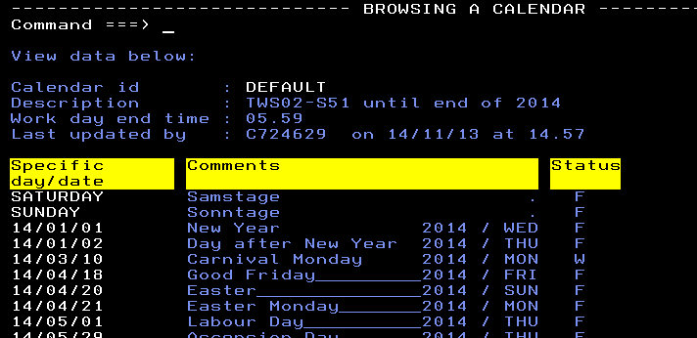
Calender in TWS:
Example screen shot of calender in TWS

Slide 11
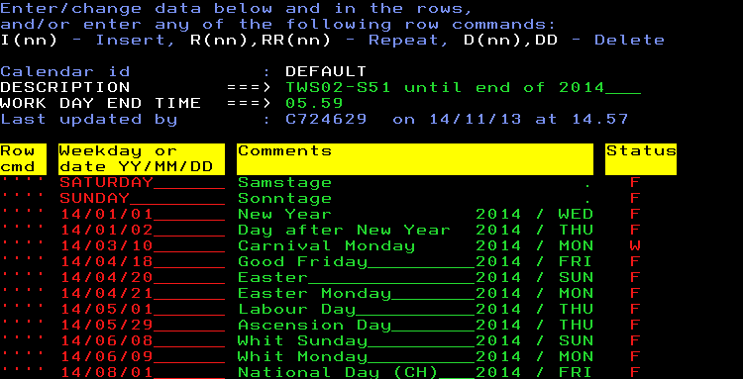
Calender in TWS:
Creating calendar in TWS

Slide 12
Types of Applications :
An application is set of related jobs or tasks
Application Descriptions
- Type A
- Contains operations
Appliction groups(Group definitions )
- Type G
- A Container for application descriptions

Slide 13
Application Descriptions(AD):
AD can hold 255 operations
Each operation must be associated with a workstation
Each operation has a unique sequence number b/w 1 – 255
Operations in AD are run in specified sequence

Slide 14
Application Groups :
Application Group is a group of Applications and job descriptions that are always scheduled together
Eg : WVT253GXZ#
Advantages :
1.Time saver When creating and maintaining Applications
2.A handy and easy way to group related applications
3.Easy way to add multiple-related applications to CP
4.Protect against accidental deletion or manual completion in CP

Slide 15
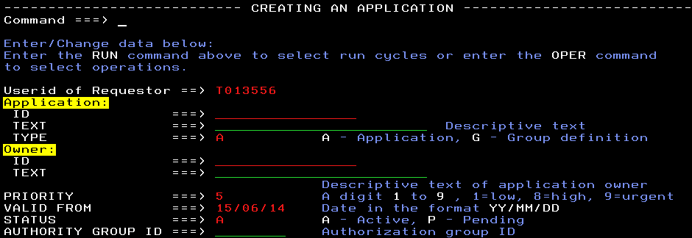
Creation of application
Creating application and its operations
Select option 1.4.2 from the main menu

Slide 16
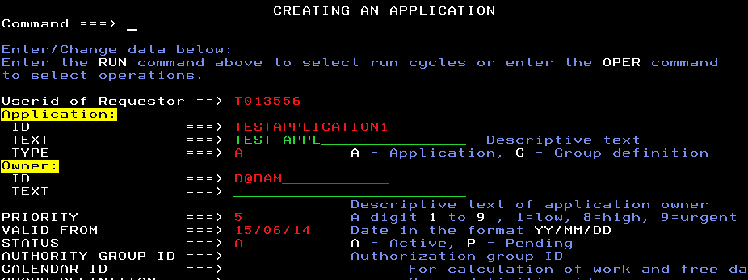
Creation of application

Slide 17
Creation of application
Create Application DBAM23000 with 2 jobs running in sequence
2. Create Application DBAM23001 With 5 jobs
1 job starting first
2nd & 3rd jobs depending on 1st
4th and 5th jobs depending on 2nd and 3
3. Create Application DBAM23003 with 10 jobs running
5 running first and 2nd 5 runing after them
4. Application with 20 jobs with 1 to 5 running in parallel
5 to 10 running in sequence depending on 1 to 5
10 to 20 running in parallel depending on 5 to 10
5.Create an Application Group and add above all applications .

Slide 18
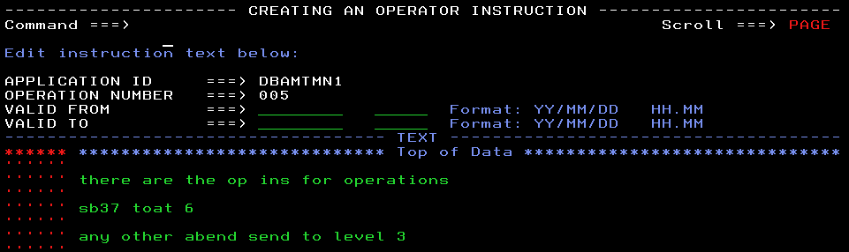
Creation of Operator instructions(op Ins)
Example screen shot showing opINS creation panel

Slide 19
Periods & offsets
Periods can be cyclic or noncyclic
Cyclic : A cyclic period starts on a specific date and has a specified number of days
There are two kinds of cyclic periods; work-days-only cyclic periods where only work days are counted, and all-days cyclic periods where all the days are counted
Example : Daily for Work-days-only cyclic
Allday for Cyclic
Non Cyclic:
A noncyclic period such has a varying interval, so you must specify the origin date of each interval
Example : Jan , feb or userdefined names

Slide 20
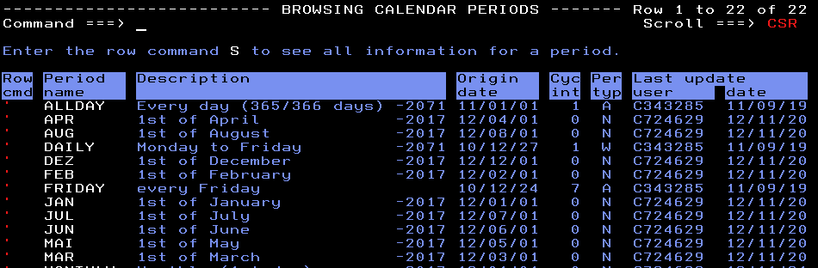
Periods
Example screen shot showing different types of periods

Slide 21
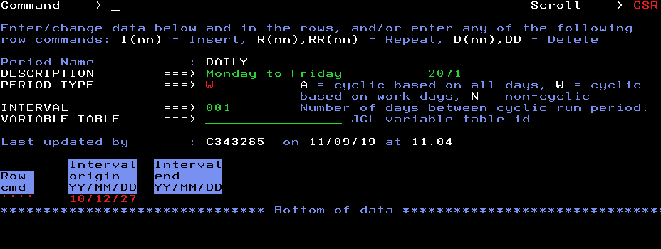
Creating periods
Example Screen shot showing period creation

Slide 22
offsets
Offsets
Have values in the range -999 to -1 and 1 to 999
These values define the day of the calendar period when the application has to run
Always used along with Periods

Slide 23
Run cycles
DBAM23000 has to run every day at 0800 excluding
Workdays till 31/12/71
DBAM23000 has to run at TIME 0300 and 1700 every day Monday to Friday including holidays till 10/11/16
DBAM23000 has to run on 3rd December every year if its holiday
should run on previous workday
DBAM23000 should run every hour on all days including holidays
DBAM23000 should run Monday to Friday including holidays except on 3rd April and 10th May till 31/12/71

Slide 24
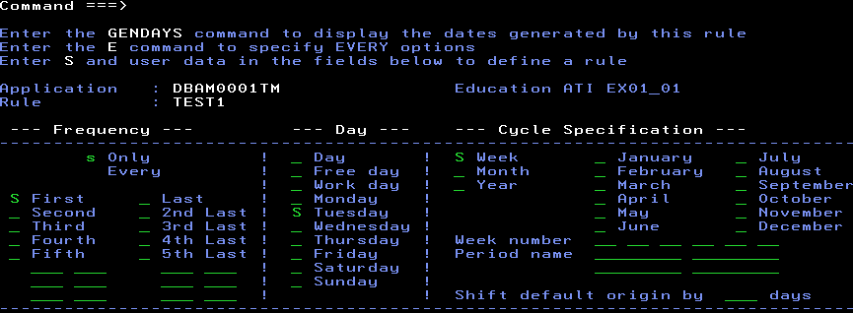
Rules
Example : Only First Tueday of the week
Every workday of the month

Slide 25
Event triggered tracking (ETT)
Method of controlling and tracking the work that cannot be planned in your production environment
event types
J type
These occur when a job or started task arrives in JES.
The first operation of the added application must be defined on the same type of computer workstation as the triggering event. In other words, if the triggering event is a batch job, the first operation of the added application must be defined on a job computer workstation

Slide 26
Contd…
R type
These occur when the availability status of a resource is set to YES
The availability of a resource can also be set automatically when a data set is closed if your installation implements the data set triggering support.
The resource may be one that is also used by operations in the current plan, or it can be a resource dedicated as an ETT trigger.

Slide 27
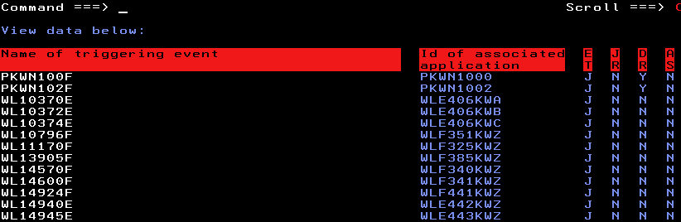
ETT
Example screen shot of ETT

Slide 28
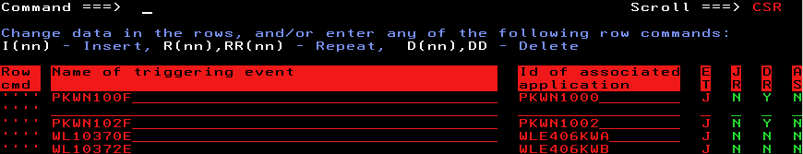
ETT
Creation of ETT

Slide 29
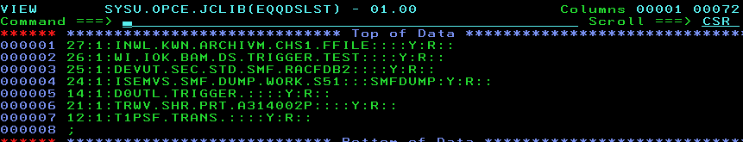
ETT
ETT

